Slide 1
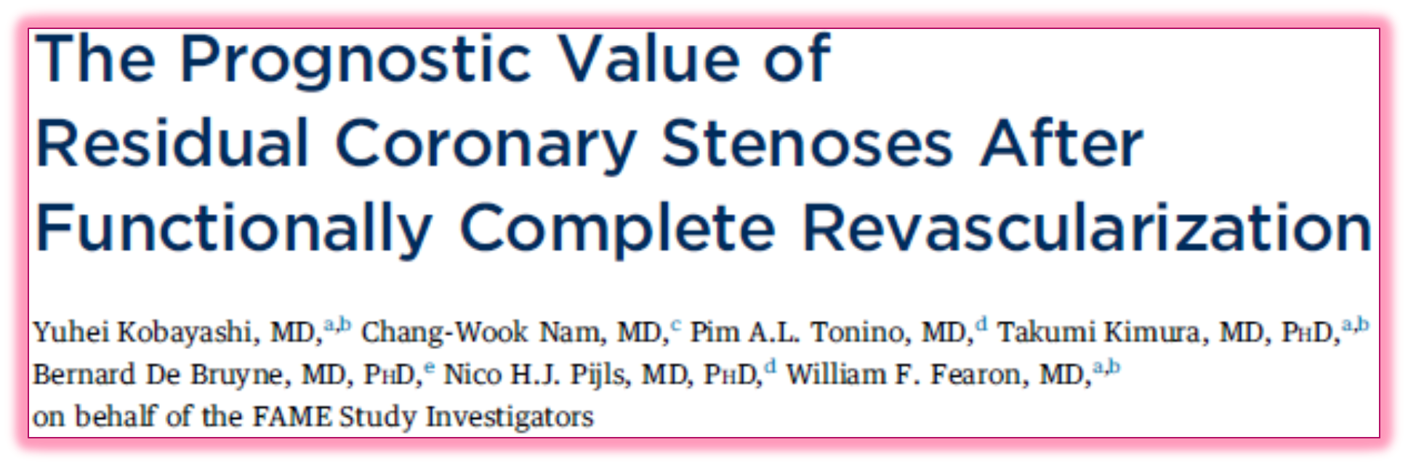

Slide 2
Introduction
CAD treatment - anatomically driven for a half-century
Favored approach for CAD management continues to be fixing all significant coronary stenosis
  Despite technological advances in both coronary revascularization and nonrevascularization treatment options
OMT
  Therapeutic lifestyle intervention + aggressive, multifaceted pharmacological secondary prevention
Notes:
The treatment of CAD has been anatomically driven for a half-century
Despite technological advances in both coronary revascularization and nonrevascularization treatment options, the overwhelmingly favored clinical approach for CAD management continues to be fixing all significant coronary stenoses
Nonrevasc includes both therapeutic lifestyle intervention and aggressive, multifaceted pharmacological secondary prevention— the combination of which is commonly referred to as OMT

Slide 3
Sophisticated noninvasive imaging modalities available
Final common diagnostic pathway - coronary angiography - obstructive CAD - myocardial revascularization
Notes:
sophisticated noninvasive imaging modalities are widely embraced and incorporated into routine clinical practice
final common diagnostic pathway seems to inevitably lead to the cardiac catheterization laboratory where the results of coronary angiography very frequently “confirm” the anatomic presence of obstructive CAD—objective findings that most cardiologists have difficulty ignoring—and that frequently result in myocardial revascularization, most often with ad hoc PCI

Slide 4
Angiographically complete Vs incomplete revascularization
Improved long-term outcome after multivessel revascularization for stable CAD in angiographically complete revascularization
Complete revascularization
  Not always pursued
  Not always achieved
Notes:
Angiographically complete revascularization is associated with improved long-term outcome after multivessel revascularization for stable coronary artery disease (CAD) compared with incomplete revascularization
However, complete revascularization is not always pursued or achievable in patients with multivessel CAD undergoing percutaneous coronary intervention (PCI).

Slide 5
Residual SYNTAX score (RSS)
to quantitatively assess the degree and complexity of residual stenoses by recalculating the SYNTAX score (SS) after PCI
SYNTAX revascularization index (SRI)
Quantification tool to assess the proportion of CAD that has been treated by PCI
Notes:
Residual SYNTAX score (RSS) - recently developed to quantitatively assess the degree and complexity of residual stenoses by recalculating the SYNTAX score (SS) after PCI
SYNTAX revascularization index (SRI) - introduced as another quantification tool to assess the proportion of CAD that has been treated by PCI

Slide 6
functional significance of a lesion
On the basis of FFR
More important determinant of future adverse cardiac events than the angiographic appearance of the lesions
PCI on angiographically significant lesions that are not functionally significant can be deferred safely with good longterm outcomes
Notes:
on the basis of FFR is a more important determinant of future adverse cardiac events than the angiographic appearance of the lesions
PCI on angiographically significant lesions that are not functionally significant on the basis of FFR can be deferred safely with good longterm outcomes
“functionally” complete revascularization with FFR guidance in patients with multivessel CAD the residual angiographic disease, which is not functionally significant, would not be predictive of outcomes, as assessed by the RSS or SRI

Slide 7
Hypothesis
“functionally” complete revascularization with FFR guidance in patients with multivessel CAD, the residual angiographic disease, which is not functionally significant, would not be predictive of outcomes, as assessed by the RSS or SRI

Slide 8
Goal
Investigate the prognostic value of RSS and SRI quantification systems in patients enrolled in the FFR-guided PCI cohort of the FAME (Fractional Flow Reserve Versus Angiography for Multivessel Evaluation) trial, who underwent functionally complete revascularization with FFR guidance

Slide 9
METHODS
Superiority
FAME trial
Prospective
Randomized
Controlled
Multicenter
FFR-guided PCI
angiography-guided PCI
multivessel CAD

Slide 10
Multivessel CAD amenable to PCI
At least 50% diameter stenosis
FFR-guided PCI
Angiography-guided PCI
FFR ≤0.80
FFR >0.80
Treated with PCI
Left untreated
All lesions treated
Notes:
In patients with multivessel CAD amenable to PCI, the investigators indicated which lesions had at least 50% diameter stenosis and were thought to require PCI.
Thereafter, patients were randomly assigned to either FFR-guided or angiography-guided PCI. In patients assigned to FFR-guided PCI, only functionally significant lesions with FFR #0.80 were treated with PCI, and functionally insignificant lesions with FFR >0.80 were intentionally left untreated; whereas in patients assigned to angiography-guided PCI, all indicated lesions were treated without measurement of FFR

Slide 11
Angiography-guided PCI not included in this study
Not undergo FFR assessment and calculation of the functional SYNTAX score (FSS)
Angiographically complete revascularization in all patients
(very little residual stenosis existed after PCI in these patients)

Slide 12
Inclusions in ACS
Patients with STEMI enrolled if the infarction had occurred at least 5 days before PCI
UA or NSTEMI allowed earlier than 5 days if the peak creatinine kinase <1,000 IU
Patients with prior PCI included
Notes:
Patients with ST-segment elevation myocardial infarction could be enrolled if the infarction had occurred at least 5 days before PCI.
By contrast, patients with unstable angina or non–ST-segment elevation myocardial infarction were allowed to enroll earlier than 5 days after myocardial infarction if the peak creatinine kinase was <1,000 IU.
Patients with prior PCI could be included

Slide 13
Exclusion
Significant left main CAD
Previous coronary artery bypass surgery
Cardiogenic shock
Extremely tortuous or calcified coronary arteries
Pre- and post-procedural angiogram data not available

Slide 14
FFR MEASUREMENT AND TREATMENT
PCI performed according to standard coronary interventional techniques, primarily with DES
FFR was measured with a 0.014-inch pressure sensor guidewire (St. Jude Medical)
After equalization to the guide catheter pressure with the sensor positioned at the ostium of the coronary artery, the pressure guidewire advanced down the target coronary artery
Notes:
PCI performed according to standard coronary interventional techniques, primarily with DES
In patients assigned to FFR-guided PCI, FFR was measured with a 0.014-inch pressure sensor guidewire (St. Jude Medical, Uppsala, Sweden)
After equalization to the guide catheter pressure with the sensor positioned at the ostium of the coronary artery, the pressure guidewire was advanced down the target coronary artery

Slide 15
To induce maximal hyperemia, intravenous adenosine was administered at 140 mg/kg/min through a central vein
Simultaneous measurement of the mean proximal coronary pressure with the guide catheter and the mean distal coronary pressure with the pressure guidewire performed
FFR was calculated as the ratio of the mean distal to proximal coronary pressure at hyperemia
All patients received dual antiplatelet therapy with aspirin and clopidogrel for at least 1 year after PCI
Notes:
To induce maximal hyperemia, intravenous adenosine was administered at 140 mg/kg/min through a central vein
Simultaneous measurement of the mean proximal coronary pressure with the guide catheter and the mean distal coronary pressure with the pressure guidewire was performed.
FFR was calculated as the ratio of the mean distal to proximal coronary pressure at hyperemia.
All patients received dual antiplatelet therapy with aspirin and clopidogrel for at least 1 year after PCI

Slide 16
SS
pre-procedural angiogram
Coronary lesion producing ≥50% diameter stenosis in vessels ≥1.5 mm by visual estimation
(SS algorithm from the SYNTAX Score website)
overall SS
The FSS calculated by deducting the individual score of lesions with an FFR >0.80
Notes:
SS was calculated from the pre-procedural angiogram, in which each coronary lesion producing ≥50% diameter stenosis in vessels ≥1.5 mm by visual estimation scored separately using the SS algorithm from the SYNTAX Score website and added to obtain the overall SS
The FSS was calculated by deducting the individual score of lesions with an FFR >0.80

Slide 17
RSS
For the RSS, a higher value suggests more CAD left untreated after PCI
post-procedural angiograms
Reviewed by a dedicated interventional cardiologist blinded to the baseline clinical characteristics, procedural data including FFR values, and clinical outcomes
obtain the RSS

Slide 18
SRI = 100 – RSS/ baseline SS ( % )
shows the proportion of CAD treated by PCI
a lower value suggests more CAD left untreated after PCI.
Post-procedural angiograms from 50 patients randomly selected and reanalyzed by the same interventional cardiologist and a second independent interventional cardiologist to assess intraobserver and interobserver variability of the RSS
Notes:
After obtaining the RSS, the SRI was calculated: 100 (1 RSS/baseline SS) (%).
For the SRI, because this tool shows the proportion of CAD that has been treated by PCI, a lower value suggests more CAD left untreated after PCI.
Post-procedural angiograms from 50 patients were randomly selected and reanalyzed by the same interventional cardiologist and a second independent interventional cardiologist to assess intraobserver and interobserver variability of the RSS.

Slide 19
Representative Cases With the Same SS, But Different FSS, RSS, and SRI
Case 1
SS = 16
FSS = 16
RSS = 0
SRI = 100%
Case 2
SS = 16
FSS = 8
RSS = 8
SRI = 50%

Slide 20
Primary endpoint
Death
Myocardial infarction
MACE
Any repeat revascularization
At 1 year after the index procedure among the RSS and SRI subgroups
Notes:
The primary endpoint of this reanalysis was the same as that of the original FAME trial:
major adverse cardiac events (MACE) (defined as a composite of all-cause death, myocardial infarction, or any repeat revascularization) and its components (all-cause death, myocardial infarction, repeat revascularization, and death or myocardial infarction) at 1 year after the index procedure among the RSS and SRI subgroups.

Slide 21
Analyses repeated with 2-year follow-up data
An independent clinical events committee adjudicated all events
(members blinded to treatment strategy)
Notes:
The previously mentioned analyses were repeated with 2-year follow-up data.
An independent clinical events committee whose members were blinded to treatment strategy adjudicated all events

Slide 22
RESULTS

Slide 23
FFR-guided PCI cohort of the FAME trial
509
unavailability of a post-procedural angiogram
427
Both pre- and post-procedural angiograms available
Patient characteristics, including age, sex, comorbidities
similar between included
and excluded patients
Number of lesions intended to be treated
Rate of MACE at 1 and 2 years
Higher incidence of unstable angina in the included patients (31.9% vs. 17.2%, p < 0.01)
Notes:
Both pre- and post-procedural angiograms were available in 427 of 509 patients from the FFR-guided PCI cohort of the FAME trial database.
The primary reason for exclusion was unavailability of a post-procedural angiogram.
Patient characteristics, including age, sex, comorbidities, the number of lesions intended to treated, and the rate of MACE at 1 and 2 years, were similar between the included and excluded patients
Higher incidence of unstable angina in the included patients (31.9% vs. 17.2%, p < 0.01)

Slide 24
In 427 patients with both pre- and post-procedural angiograms, the mean SS, FSS, RSS, and SRI were 14.4 7.2, 10.8 8.0, 6.5 5.8, and 55.1 32.5%, respectively.
The intraobserver variability of the RSS using the intraclass correlation analysis was 0.95, 95% CI: 0.92 to 0.97 (p < 0.001)
interobserver variability of the RSS using the intraclass correlation analysis was 0.92, 95% CI: 0.87 to 0.96 (p < 0.001)

Slide 25
SCORE | pre- procedural angiogram | post-procedural angiogram
SS | 14.4 | 7.2
FSS | 10.8 | 8.0
RSS | 6.5 | 5.8
SRI | 55.1% | 32.5%

Slide 26
CORRELATIONS BETWEEN DIFFERENT SCORING SYSTEMS

Slide 27
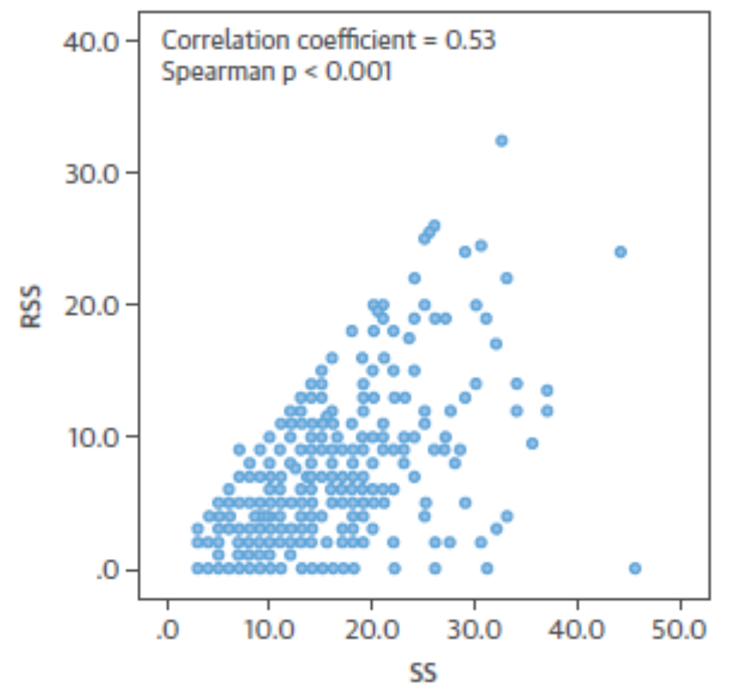
integration of functional information into the RSS and SRI should improve the prognostic value
Notes:
The FSS and RSS were significantly correlated with the SS (correlation coefficient ¼ 0.80 and Spearman p < 0.001 between the FSS and SS, and correlation coefficient ¼ 0.53 and Spearman p < 0.001 between the RSS and SS, respectively),

Slide 28
Notes:
RSS was not correlated with the FSS (correlation coefficient ¼ 0.09 and Spearman p ¼ 0.07).

Slide 29
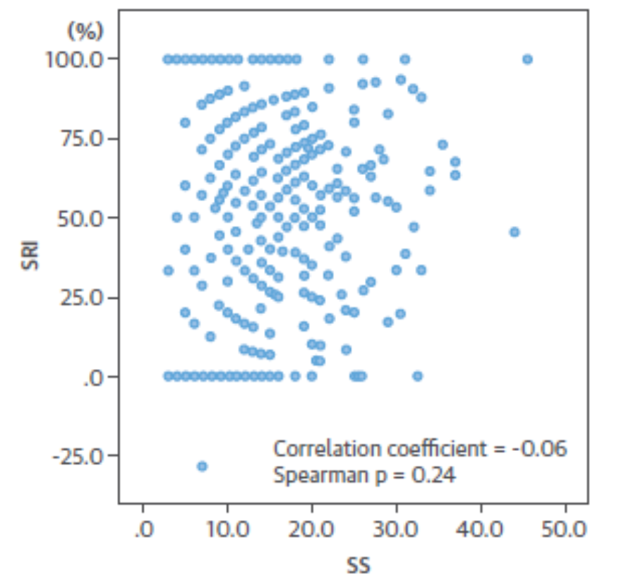
finding that the SRI positively correlated with the FSS explains that the SRI had no prognostic value because the SRI should be negatively correlated with the FSS to be prognostic
Notes:
The SRI was not correlated with the SS (correlation coefficient ¼ 0.06 and Spearman p ¼ 0.24). However, the SRI was positively correlated with the FSS (correlation coefficient ¼ 0.37 and Spearman p < 0.001)
finding that the SRI positively correlated with the FSS explains that the SRI had no prognostic value because the SRI should be negatively correlated with the FSS to be prognostic.

Slide 30
Notes:
SRI negatively correlated with the RSS (correlation coefficient ¼ 0.84 and Spearman p < 0.001).

Slide 31
COMPARISONS OF BASELINE DATA AMONG THE RSS AND SRI SUBGROUPS
Baseline patient clinical characteristics were similar among the RSS and SRI subgroups
Except for
  Diabetes in the RSS and SRI subgroups (p 0.02 and p 0.007)
  History of myocardial infarction in the SRI subgroups (p 0.03)
Diabetes was lowest in patients with RSS 0 and SRI 100%, which represents angiographically complete revascularization

Slide 32
Notes:
Baseline patient clinical characteristics were similar among the RSS and SRI subgroups, except for the incidence of diabetes in the RSS and SRI subgroups (p ¼ 0.02 and p ¼ 0.007, respectively) and the history of myocardial infarction in the SRI subgroups (p ¼ 0.03). The incidence of diabetes was lowest in patients with RSS ¼ 0 and SRI ¼ 100%, which represents angiographically complete revascularization

Slide 33
Notes:
Baseline patient clinical characteristics were similar among the RSS and SRI subgroups, except for the incidence of diabetes in the RSS and SRI subgroups (p ¼ 0.02 and p ¼ 0.007, respectively) and the history of myocardial infarction in the SRI subgroups (p ¼ 0.03). The incidence of diabetes was lowest in patients with RSS ¼ 0 and SRI ¼ 100%, which represents angiographically complete revascularization

Slide 34
With increasing RSS
SS increased
Number of lesions intended to treat increased
FSS did not vary
Total number of stents per patient decreased
Total stented length per patient decreased

Slide 35
with decrement of SRI
The SS, FSS, and number of lesions intended to treat did not vary in a predictable fashion
Total implanted stents per patient
Total stented length per patient
volume of contrast agent
Decreased

Slide 36
CLINICAL OUTCOMES
MACE at 1 year occurred in 53 patients (12.4%)
patients with MACE had higher SS and FSS than patients without MACE
RSS and SRI were similar between patients with and without MACE
Notes:
MACE at 1 year occurred in 53 patients (12.4%)
patients with MACE had higher SS and FSS than patients without MACE
whereas RSS and SRI were similar between patients with and without MACE (RSS: 6.0 [interquartile range (IQR): 3.0 to 10.0] vs. 5.0 [IQR: 2.0 to9.5], p ¼ 0.51 and SRI: 60.0% [IQR: 40.9% to 78.9%] vs. 58.8% [IQR: 26.7% to 81.8%], p ¼ 0.24, respectively).

Slide 38
MACE and each component of MACE were not different among the RSS and SRI subgroups at 1 year
Kaplan-Meier curves at 1 year showed no significant separation
Among RSS and SRI subgroups
When stable and unstable patients analyzed separately
when patients with SS 0 to 22 and with SS >23 analyzed separately

Slide 39
Notes:
MACE and each component of MACE were not different among the RSS and SRI subgroups at 1 year

Slide 40
Kaplan – Meier curves at 1 year
showed no significant separation
Notes:
Kaplan-Meier curves at 1 year stratified by RSS and SRI showed no significant separation

Slide 41
2-YEAR CLINICAL OUTCOME DATA
To test the durability of the results with longer-term follow-up
Same analyses repeated with 2-year outcome data
MACE occurred in 74 patients (17.3%) at 2 years
Patients with MACE had higher SS and FSS than patients without MACE
RSS and SRI were similar between patients with and without MACE

Slide 42
2-YEAR CLINICAL OUTCOME DATA
MACE and each component of MACE were not different among the RSS and SRI subgroups at 2 years
Kaplan-Meier curves at 2 year showed no significant separation
Among RSS and SRI subgroups
When stable and unstable patients analyzed separately
when patients with SS 0 to 22 and with SS >23 analyzed separately

Slide 43
DISCUSSION - The principal finding of the present study
RSS and the SRI do not predict MACE at 1- and 2-year follow-up in patients with multivessel CAD after functionally complete revascularization
Reinforce that an FFR guided PCI strategy offers sufficient revascularization
PCI of angiographically significant, but not functionally significant, lesions can be safely deferred
Raise the question of whether RSS and SRI scores should be applied without accounting for the FFR result of specific lesions

Slide 44
FSS better stratified the risk of MACE in patients undergoing multivessel FFR-guided PCI (based on previous FAME substudy)
Fact that the RSS correlated significantly with the SS, but not with the FSS, explain why the RSS had no prognostic value after functionally complete revascularization
With each decrement of the RSS, the number of lesions intended for treatment increased but the actual number and length of stents implanted decreased
Patients with an RSS >8 had the highest baseline SS, but received the fewest number and shortest length of stents
( long-term outcome was similar compared with the other subgroups )
Notes:
Previous FAME trial substudy, the FSS better stratified the risk of MACE in patients undergoing multivessel FFR-guided PCI (counts only functionally significant lesions on the basis of FFR assessment, compared with the SS)
Therefore, the fact that the RSS correlated significantly with the SS, but not with the FSS, may explain why the RSS had no prognostic value after functionally complete revascularization
This finding was similar when the SS and FSS were compared among the 4 RSS subgroups.
With each decrement of the RSS, the number of lesions intended for treatment increased; however, the actual number and length of stents implanted decreased.
In other words, patients with an RSS >8 had the highest baseline SS, but received the fewest number and shortest length of stents; nevertheless, the long-term outcome was similar compared with the other subgroups.

Slide 45
Finding that the SRI positively correlated with the FSS explains that the SRI had no prognostic value because the SRI should be negatively correlated with the FSS to be prognostic
With each decrement of the SRI, the number of lesions indicated tended to increase; however, the actual number/ length of stents implanted decreased, and the long term outcome was similar
Suggest that a scoring system with a purely anatomic approach may be insufficient, not only for the pre-procedural assessment, but also for the post-procedural assessment for predicting outcome after PCI.

Slide 46
RSS and SRI associated with worse long-term outcomes after angiography guided PCI highlight importance of angiographically complete revascularization in managing patients with stable angina and multivessel CAD
Angiographically complete revascularization is better than angiographically incomplete revascularization
This study supports the concept that functionally complete revascularization is as good as angiographically complete revascularization, if not better

Slide 47
OBSERVATION | INFERENCE
RSS correlated significantly with the SS, but not with the FSS | RSS had no prognostic value after functionally complete revascularization
With decrement of the RSS, the number of lesions intended for treatment increased but the actual number and length of stents implanted decreased | “
Patients with an RSS >8 had the highest baseline SS, but received the fewest number and shortest length of stents | “
SRI positively correlated with the FSS | SRI had no prognostic value
With decrement of the SRI, the number of lesions indicated tended to increase but the actual number/ length of stents implanted decreased, and the long term outcome was similar | “
scoring system with a purely anatomic approach may be insufficient, not only for the pre-procedural assessment, but also for the post-procedural assessment for predicting outcome after PCI.

Slide 49
STUDY LIMITATIONS
May not be applicable for patients with STEMI because patients with ST-segment elevation myocardial infarction within 5 days were excluded
Do not have a control arm because all angiographically significant lesions in angiography-guided PCI cohort were treated with PCI
Small proportion of functionally significant lesions may have been left untreated due to the complexity of CAD anatomy, procedural failure, or the operator’s discretion
Because the baseline complexity of CAD is relatively low in this population, results may not apply to patients with more extensive CAD
Study being a post hoc analysis of the FFR-guided PCI arm of the FAME trial, which was not designed to assess the impact of residual lesions or the extent of revascularization after FFR-guided PCI, should be interpreted as hypothesis-generating
Notes:
First, because patients with ST-segment elevation myocardial infarction within 5 days were excluded, our results may not be applicable for patients with ST-segment elevation myocardial infarction and with multivessel CAD undergoing PCI
Second, we do not have a control arm in this substudy because all angiographically significant lesions of patients enrolled in the angiography-guided PCI cohort were treated with PCI.
Third, although the intention was for functionally complete revascularization in all patients, a small proportion of functionally significant lesions may have been left untreated due to the complexity of CAD anatomy, procedural failure, or the operator’s discretion.
Fourth, because the baseline complexity of CAD is relatively low in this population, our results may not apply to patients with more extensive CAD. However, the outcomes at 1 and 2 years did not differ among the RSS and SRI subgroups, irrespective of baseline SS stratification, suggesting the applicability of our results to patients with more complex CAD.
Finally, because this study is a post hoc analysis of the FFR-guided PCI arm of the FAME trial, which was not designed to assess the impact of residual lesions or the extent of revascularization after FFR-guided PCI, the results of the present study should be interpreted as hypothesis-generating.

Slide 50
Conclusions
After functionally complete revascularization with FFR guidance, the residual functionally insignificant lesions do not increase the risk for MACE
Angiography-based RSS and SRI do not predict a worse long-term outcome in these patients
Supports the concept of functionally complete revascularization, rather than angiographically complete revascularization

Slide 51
Do these findings provide insight into the design and conduct of current trials?
Whether revascularization plus OMT of ischemia-producing disease is superior to OMT alone in a large population of stable CAD patients remains unproven !!!
  ISCHEMIA

Slide 52
ISCHEMIA trial
International Study of Comparative
Health Effectiveness with
Medical and Invasive Approaches
long-term superiority
Revascularization of choice
plus OMT
OMT alone
(FFR-guided PCI or CABG surgery)
Composite endpoint of cardiovascular death or myocardial infarction
In subjects with moderate-to-severe ischemia as assessed by stress studies
Notes:
International Study of Comparative Health Effectiveness with Medical and Invasive Approaches
Ongoing trial
Will hopefully provide some clarity
designed and powered to evaluate the long-term superiority of revascularization of choice (FFR-guided PCI or CABG surgery) plus OMT versus a strategy of OMT alone for the composite endpoint of cardiovascular death or myocardial infarction in subjects with moderate-to-severe ischemia as assessed by stress imaging studies

Slide 53
FAME-3 trial
3-vessel CAD
FFR-guided PCI
with newgeneration DES
CABG surgery
Directly test physiologically versus anatomically directed revascularization
Notes:
seeks to address a similar question in patients with 3-vessel CAD who are randomized to an FFR-guided PCI approach with newgeneration drug-eluting stents versus CABG surger (13), which will directly test physiologically directed versus anatomically directed revascularization strategies, respectively

Slide 54
Until these ongoing studies conclude, clinicians will need to make individual revascularization decisions based on currently available trials data

Slide 55
Present analysis adds to scientific evidence
Physiologically directed PCI approach to identifying and treating only functionally significant coronary stenoses
Lead to better clinical outcomes
Defines a path forward to utilize PCI in a more selective, safe, and cost-effective manner

Slide 56
THANK YOU

